Slide 1
Note-taking
SLS 1101
Sue Johnson
1

Slide 2
Three parts to effective note-taking - Observing:
A. Set the stage:
Complete the assignments
Bring the right materials
Sit up front – fewer distractions; sitting in back can signal a lack of commitment to the class
2

Slide 3
Observing:
B. Focus your attention
Notice when your mind wanders
Predict questions and ask
Pay attention to the instructor – look for verbal/non-verbal cues
Watch your attitude regarding the instructor’s style – postpone judgment
Participate
3

Slide 4
Observing:
C. Watch for cues:
Repetitions
Key phrases
Copy everything on board or overheads
4

Slide 5
II. Recording:
A. Cornell Notes
B. Mind maps
C. Formal outline
D. Short paragraphs – put key word out to the side
E. Pictures and diagrams
Make relationships visual
F. Use three-ring binders
G. 3 X 5 cards – useful for research and studying
Source cards
Information cards
H. Label and date all notes
5

Slide 6
Cornell Method of Note-taking
Recall/ Summary | Main Column
Key words | Record the most important facts and ideas in this column
Summary
6

Slide 7
Mind - Maps
Sample:
Detail
Topic
Detail
Detail
7

Slide 8
Hierarchy
Topic
Sub-topic
Sub-topic
Sub-topic
8

Slide 9
Formal Outline
Topic
A. Sub topic
1. Supporting detail
2. Supporting detail
B. Sub topic
1. Supporting detail
2. Supporting detail
Topic
A. Sub topic
1. Supporting detail
2. Supporting detail
B. Sub topic
1. Supporting detail
2. Supporting detail
9

Slide 10
Reviewing:
A. review within 24 hours
B. Edit notes – make sure everything is legible
C. Fill in key words on the left-hand column
D. With Cornell notes, cover notes and use left-hand column for review
E. Do short weekly reviews of all notes
F. Type up notes – neater, more concise, helps focus
10

Slide 11
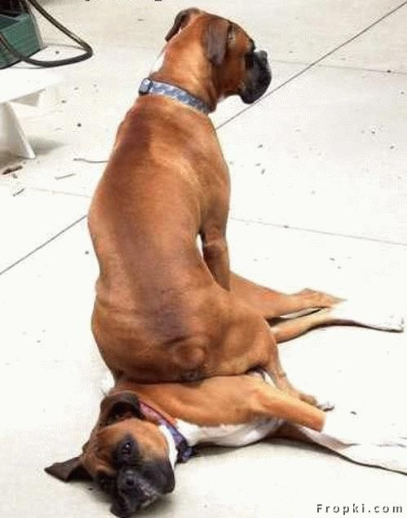
That’s all!

